Slide 1
Ideal place in London to live guide for a Polish student
My Polish friend (imaginatory) wants to study and work in London (let's ommit BREXIT stuff, and so on, this is fully imaginatory quest). He/She asked me which part of London should he/she live. As beginner data scientist I've wanted to help my friend with bunch of analysis. My friend has a couple of criteria that I should take into account in my analysis:
Price of a flat rental
Public transport accesability
Safety of cetain area
General satisfaction of living in certain area
Green space in neighborhood
Distance to city center
Polish venues in given area
My goal is to find an area in London will be the most satisfying for my friend. He/she wants to study and work part time. He/she will commute often therefore area should have great accesibility to public transport.

Slide 2
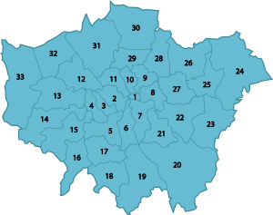
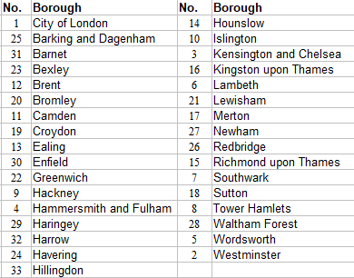
Boroughs in London
London is the biggest city in European Union. It is divided on 32 boroughs and 1 single City of London.
Below you can find map of boroughs and list of all London boroughs.

Slide 3
London data description
1) Prices of accomodation – it is an average or median prices for given borough for certain falt type. There are few flat types (one room, two rooms etc., studio, room). We will be focused on room type, since my colleague is a student, and has limited budget
2) Boroughs description – Among many data I've choosen few of them:
Public transport accesability, general safety of cetain area (measured by crime rate), general satisfaction of living (measured with happiness score), green space in neighborhood – measured as % of green areas in neighborhood, distance to city center
3) Polish venues in given area – For this purpose I used Forsquare and I've scrapped venues with Polish words in it. It serves for calculating density of Polish venues in given borough

Slide 4
Way of calculation
The best borough to live in will be the one with greatest sum of the score. Score are givent for every factor i.e. Room price, Crime rate, Public transport, Happiness score, "Polish spirit" and distance.
Please note that those factors were scaled down to 0 - 1 range, by use of min – max method. It means that 0 means the worst among neighbors while 1 means the best one.
It should be noted as well that 1 in case of "negative" factors like crime rate or distance higher score means lower value of undesirable factor in given borough. Calculation looked like this:
In main excercise I made only x 1 scalar, however it depends on your preferences. In case that my frined would wwight more public transport accesibility than happiness score it can be changed

Slide 5
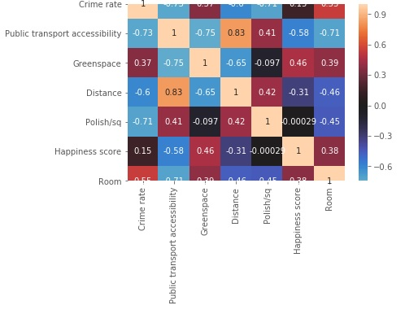
Correlation matrix of given factors
Few observations from correlation matrix:
1) Positive correlation of distance and public transport accessibility.
2) Negative correlation of safety (crime rate) with distance and public transport. Density of felonies are placed towards the center of the city. Only slight positive correlation between happiness and safety is peculiar.
3) Happiness is positively correlated only with greenspace, distance and beforementioned safety.
4) When it comes to "Polish spirit" it is not correlated with happiness at all.
5) Room prices are negatively correlated with distance and public transport vicinity. Higher prices are observed for boroughs with lower happiness and lower greenspace.

Slide 6
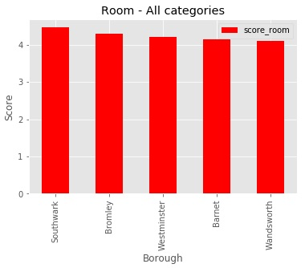
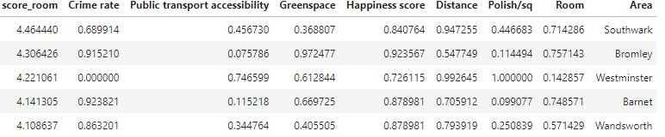
And the winner is...
Southwark is a place with the highest score amoung boroughs. It seems that despite moderate score of crime rate and low green space Southwark won due to small distance to center, rather good prices and moderate transport accesibility
.
Top 2 is Bromley with Great safety and huge green ares and good price. Distance however is grater and accesibility to public transport is rather poor.
Top 3 is Westminster with Great vicinity to center, Polish accents and public transport, however it is characterised with high prices and highest crime rate among other borough

Slide 7
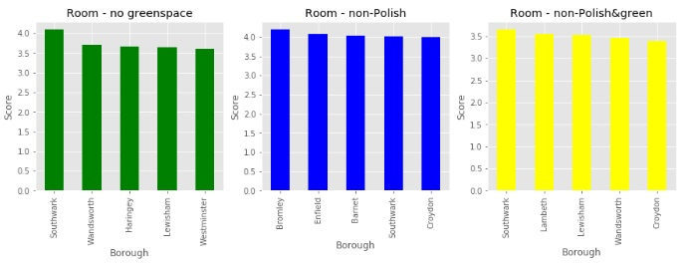
Other Combinations
Win of Southwark was given if we take into account all factors equally. Here we have some other combinations: If we would not take into account green areas Southwark will be the leader as well. However 4 other boroughs will change.
I will skip Polish spirit category it seems that Bromley now is the leader.
In case of non Polish and non-green, Southwark is again the leader
This is only beggining. These are just few combinations, more can be find if instead of x1 scalar, the other will be used. In order to do that I would need to have utility function.

